Slide 1
CNNs (Convolutional Neural Networks)

Slide 2
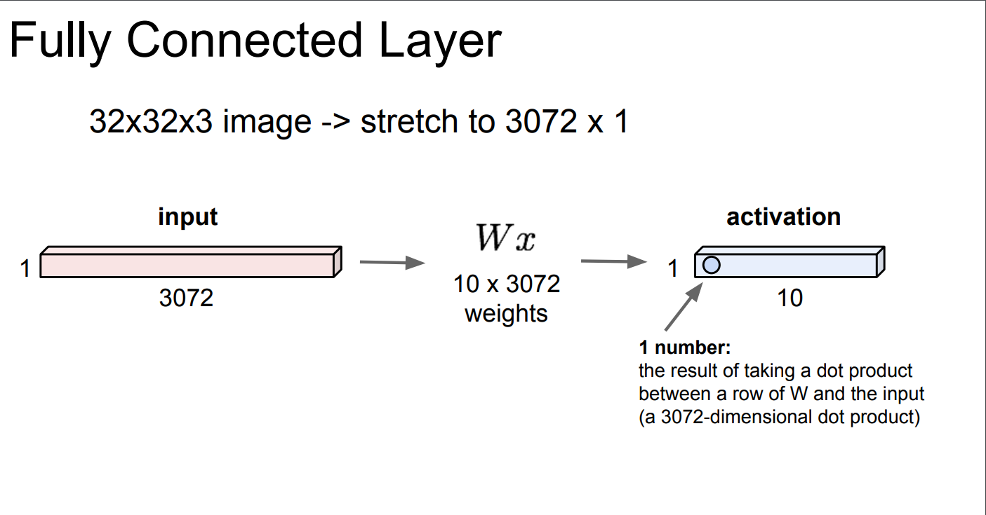
In your last assignment with Fashion Mnist…

Slide 3
Two problems with this approach
In the Fashion MNIST dataset, each input image has dimensions of 28x28 pixels, resulting in an input size of 784.
However, if we switch to a full HD resolution of 1920x1080 pixels, the input size would increase to 2,073,600, which poses significant computational challenges due to the high dimensionality.
Spatial invariance – network’s ability to recognize patterns, features or objects regardless of their location within the frame.

Slide 4
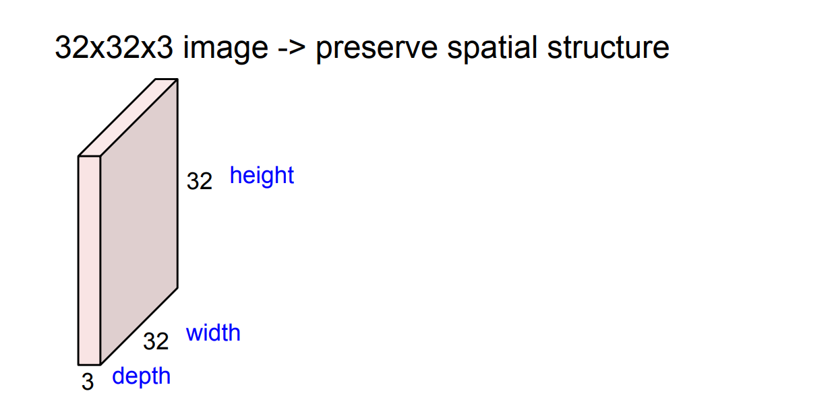
We don’t want to reshape image into vector

Slide 5
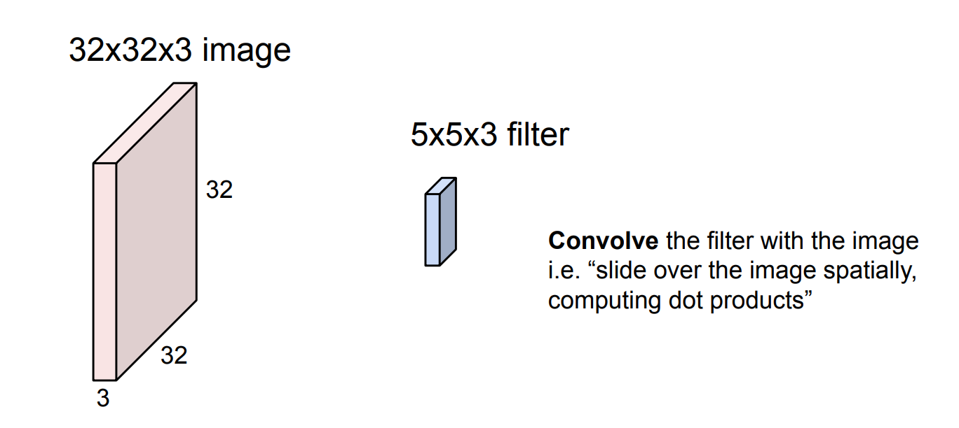
We define filters that will allow us to extract important features from the image.

Slide 6
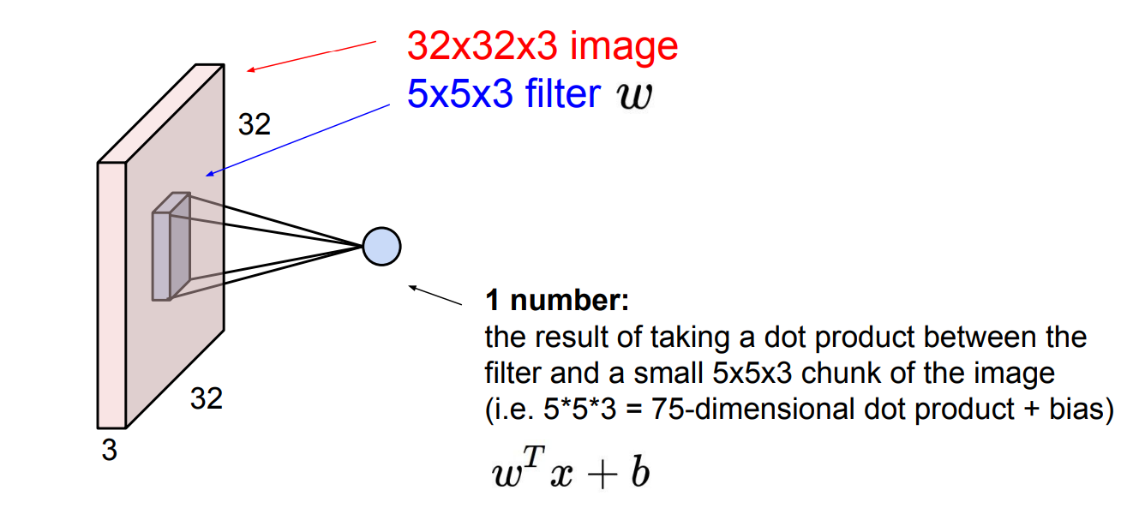
We apply filter to the image to calculate the dot product

Slide 7
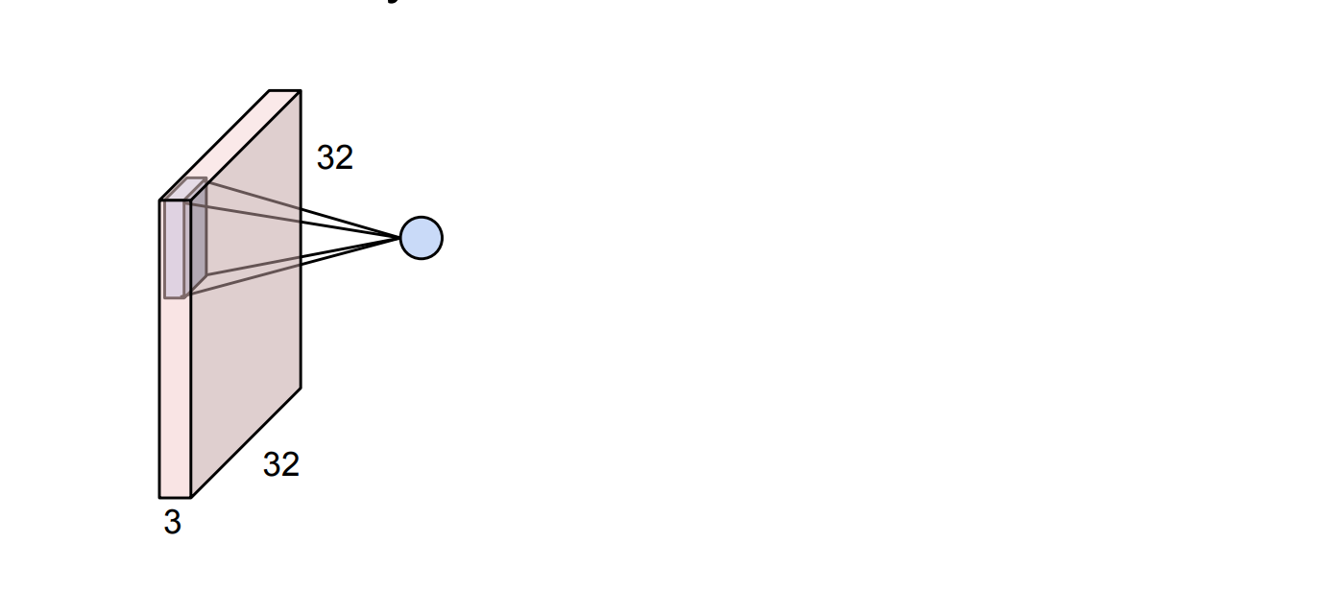
We fit the first filter and calculate the first dot product…

Slide 8
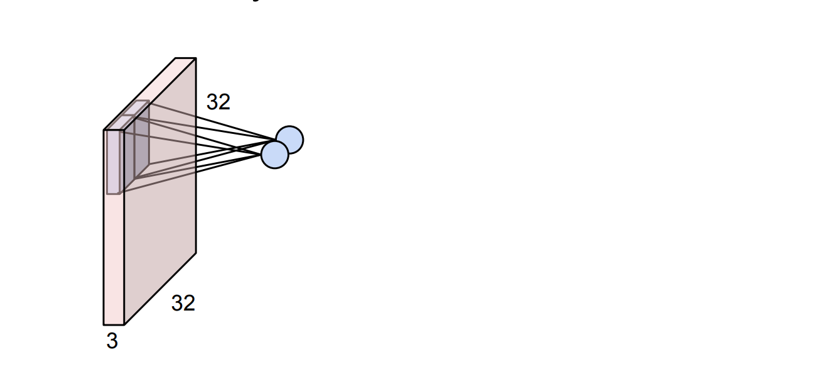
Then the second one…

Slide 9
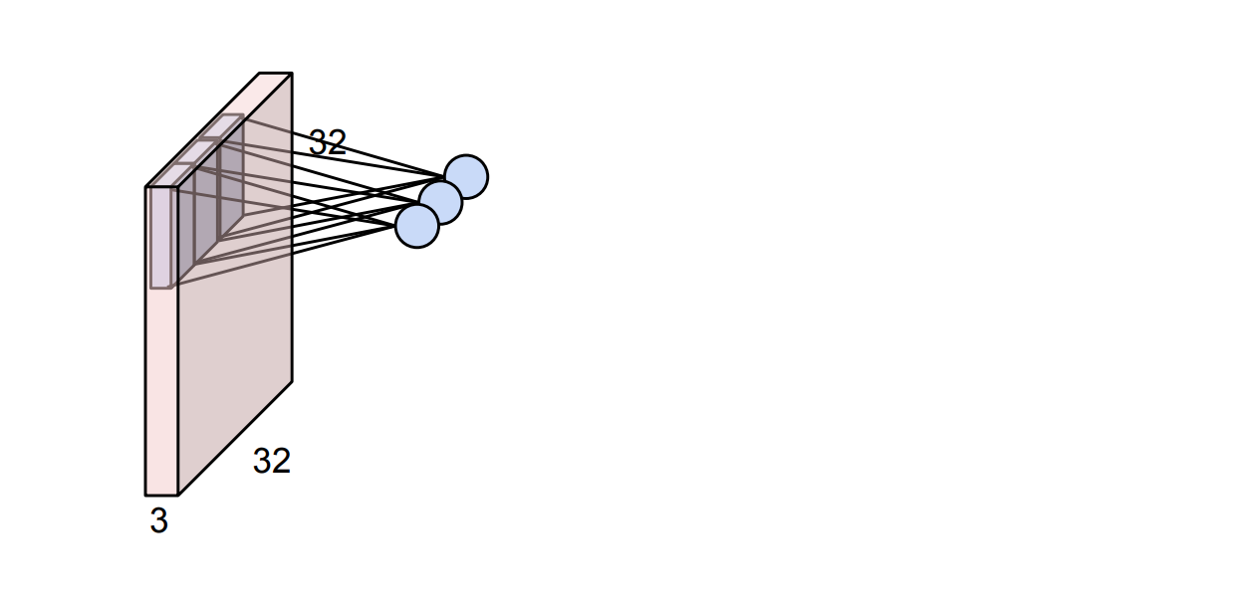
Then the third one…

Slide 10
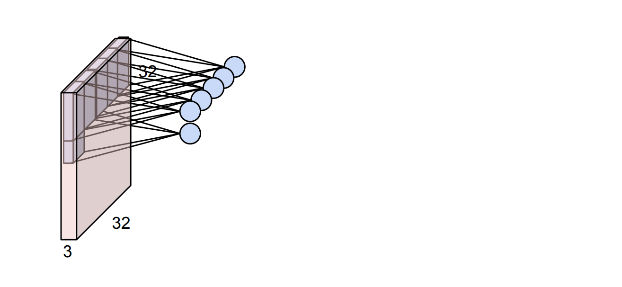
And we go further...

Slide 11
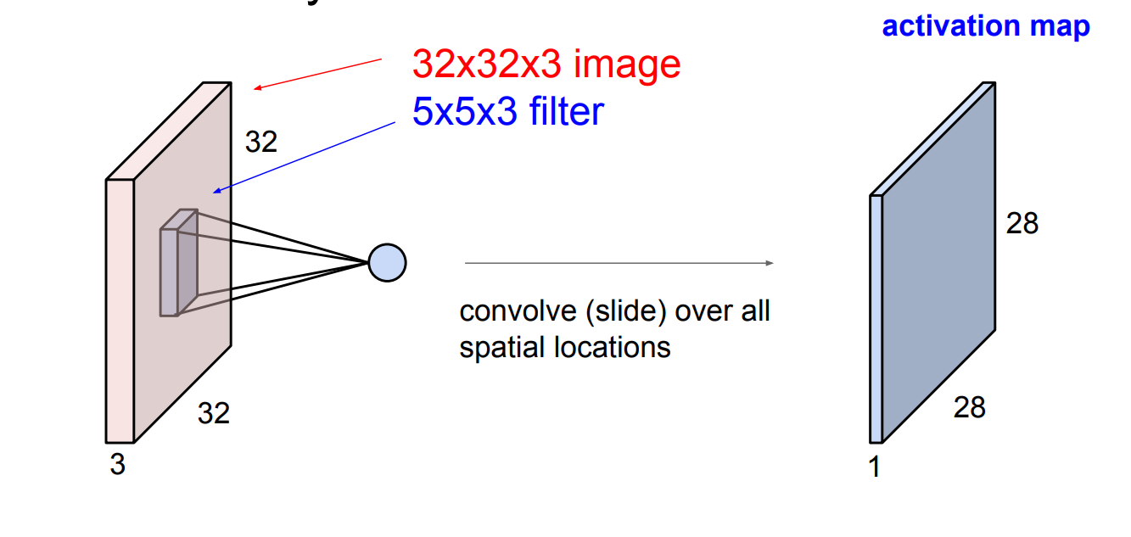
The output of this operation has a specific dimension

Slide 12
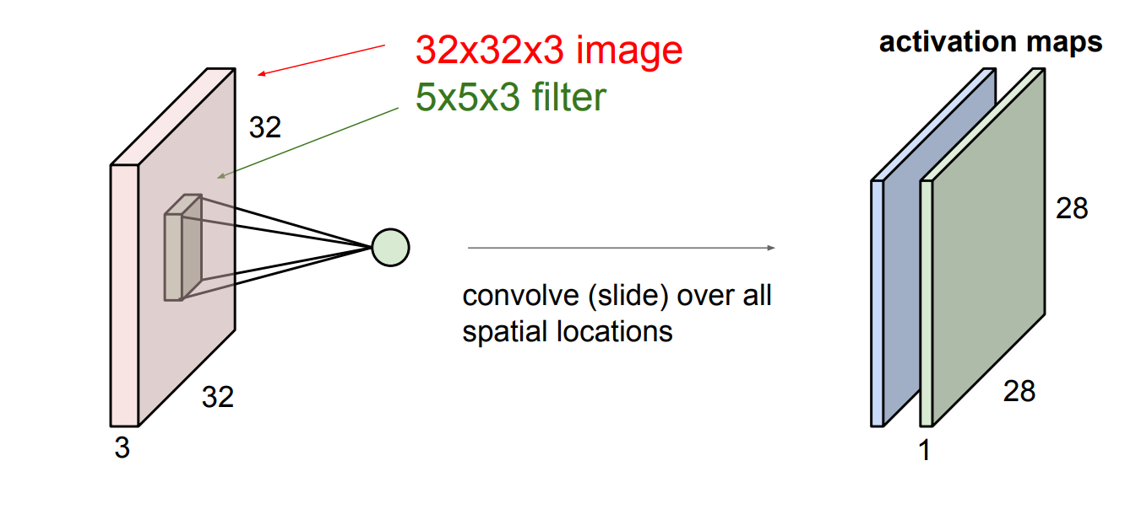
Usually we use more than one filter

Slide 13
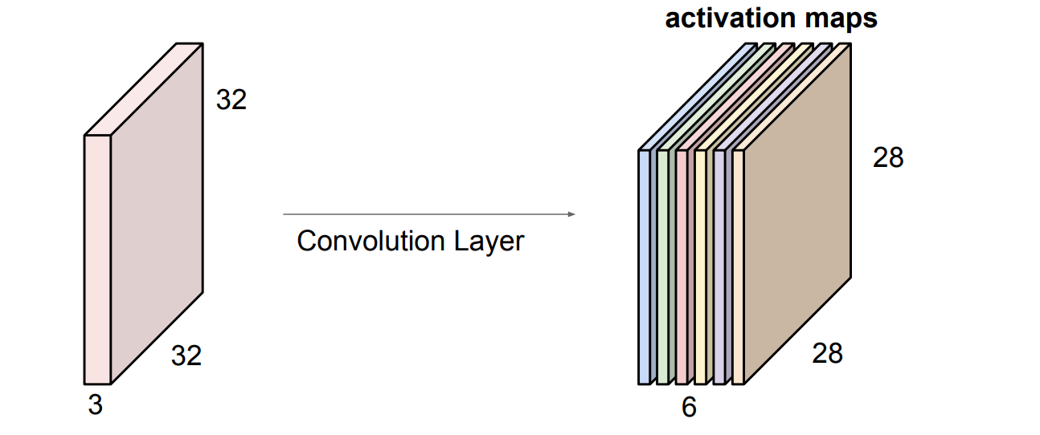
What happens if we apply 6 filters?

Slide 14
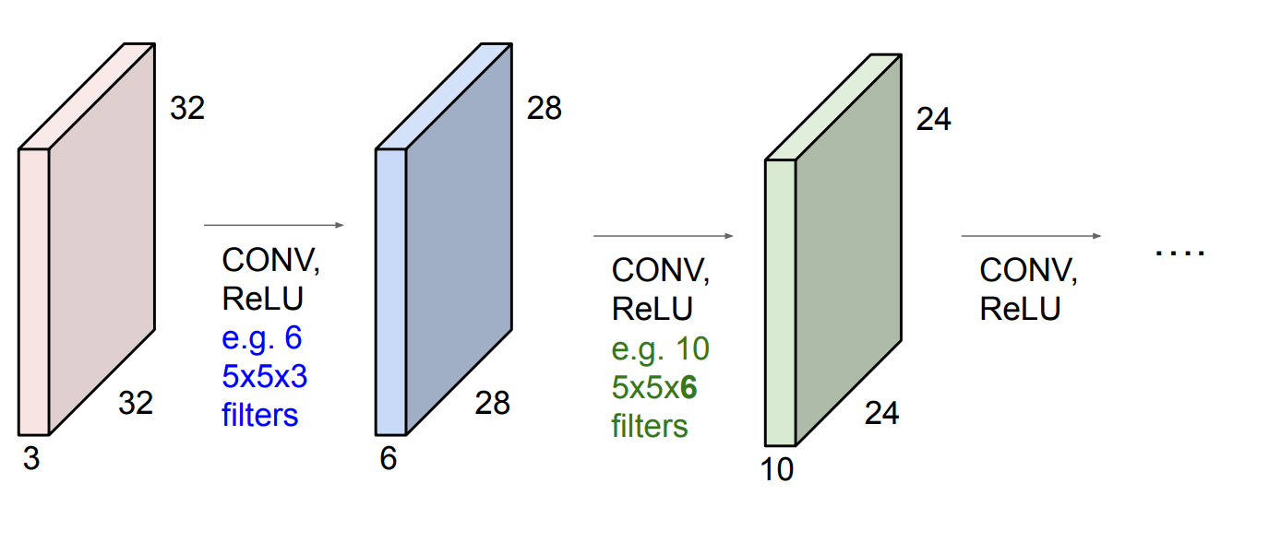
Then we do this several times…

Slide 15
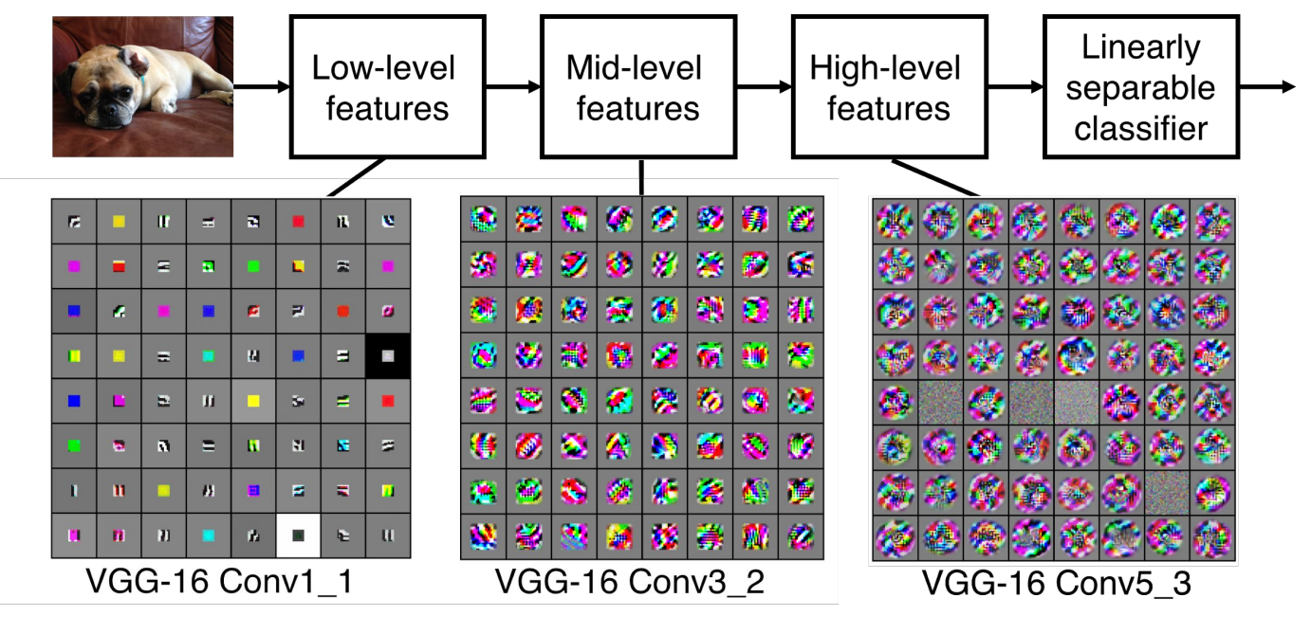
Filter Hierarchy

Slide 16
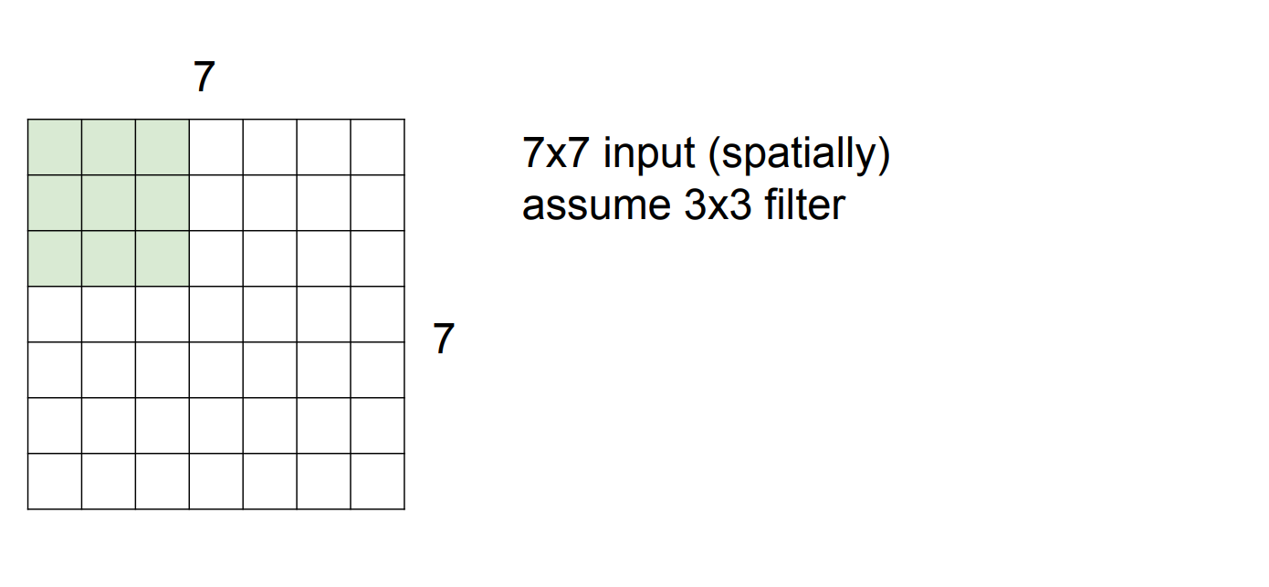
Now let’s have a closer look to spatial dimensions.

Slide 17
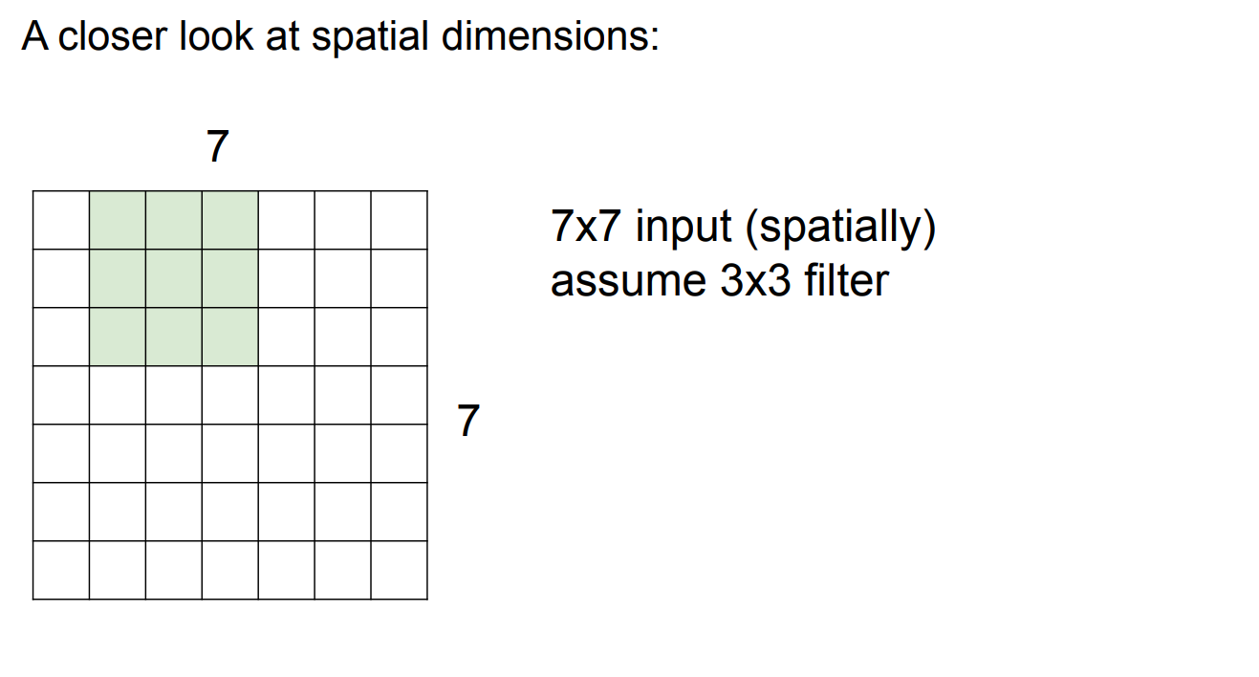
We slide the window…

Slide 18
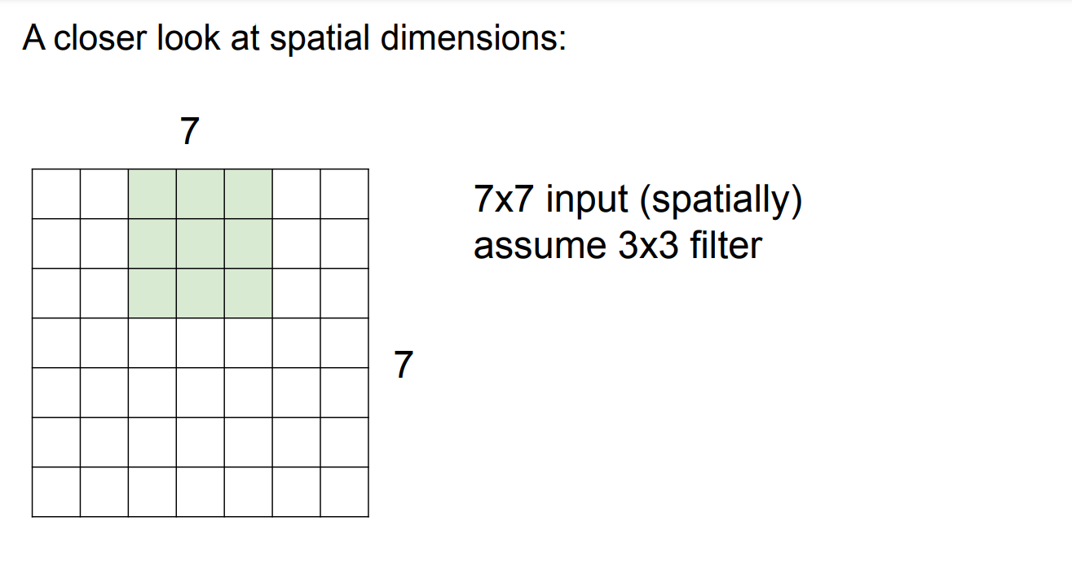
And slide…

Slide 19
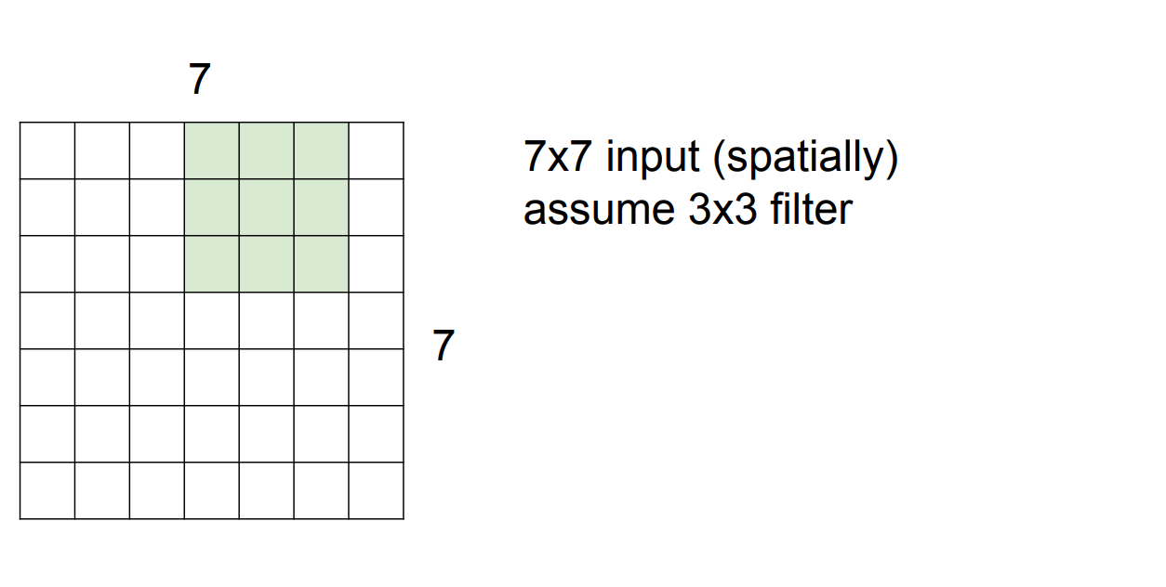
And slide…

Slide 20
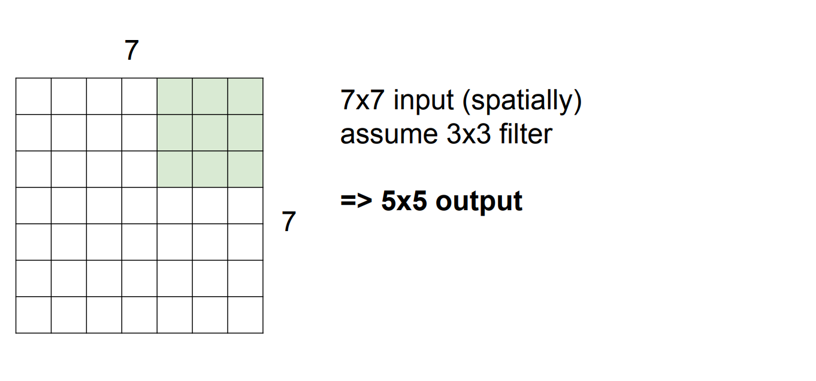
And finally…

Slide 21
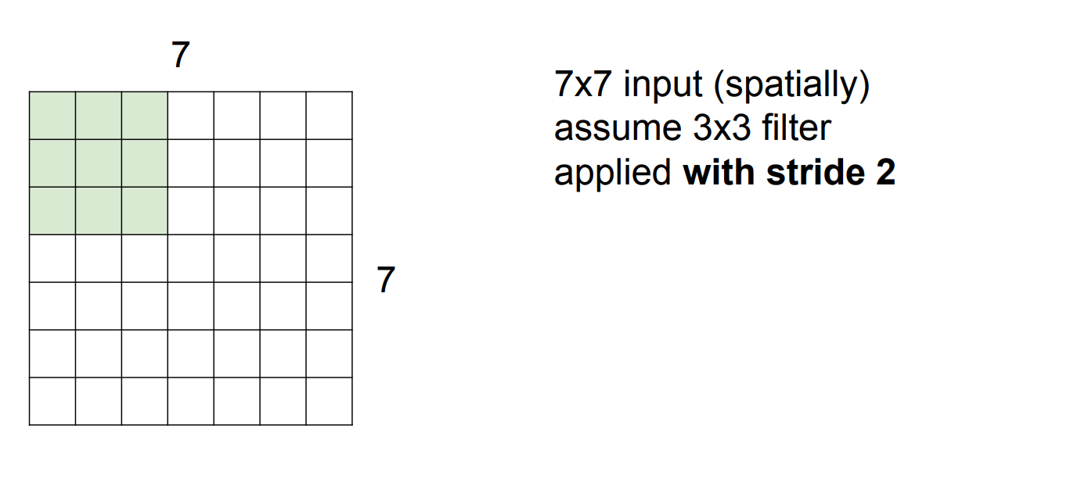
Let’s now do it with stride!

Slide 22
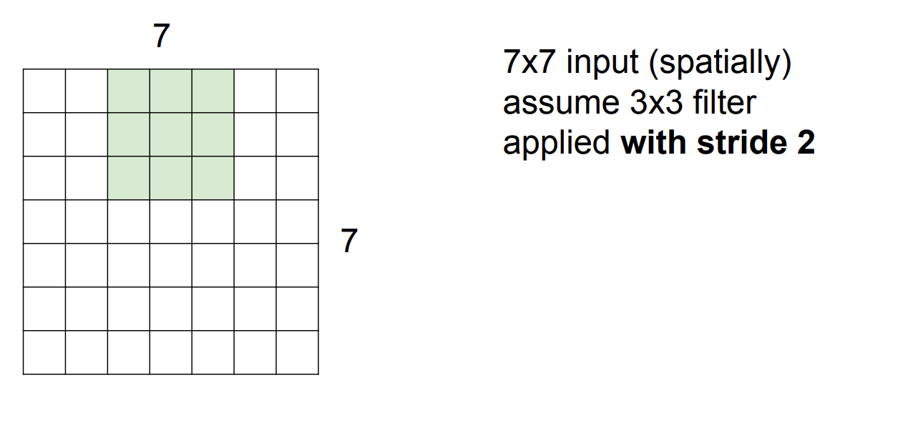
We slide but with a space!

Slide 23
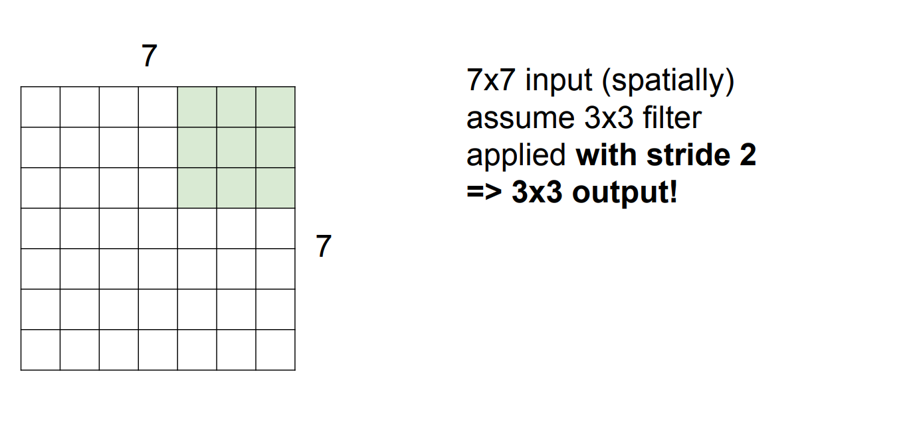
Finally…

Slide 24
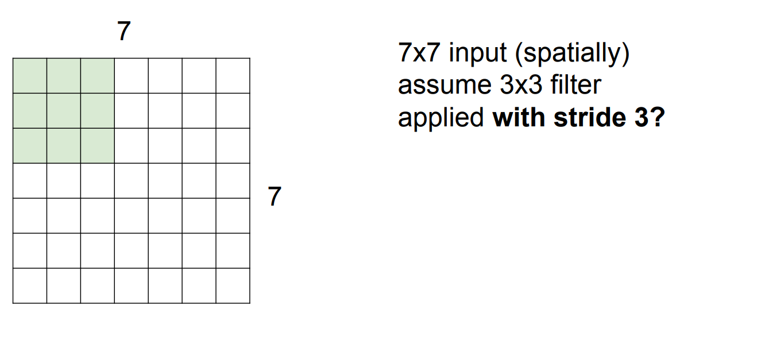
What would happen if we want to apply it with stride 3?

Slide 25
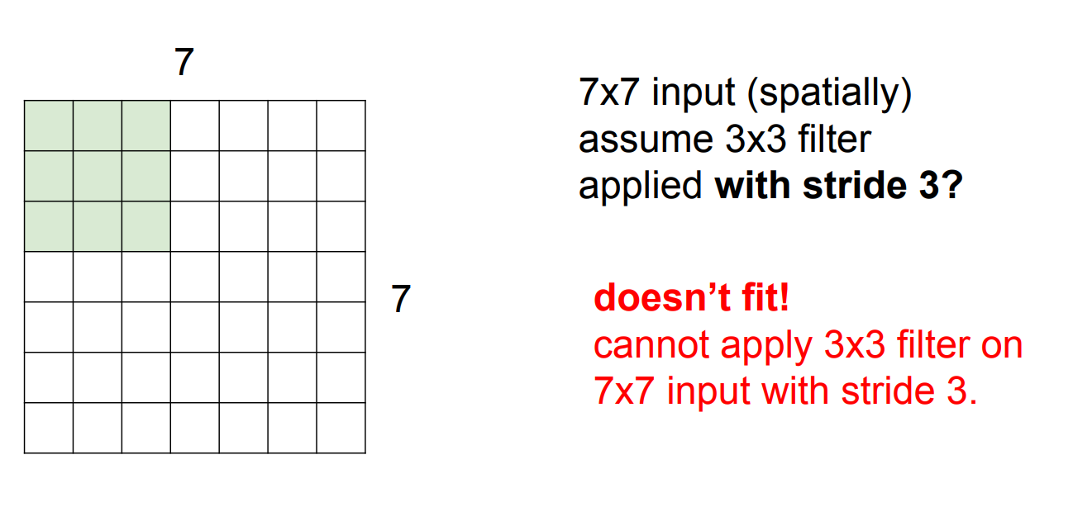
It doesn’t fit!

Slide 26
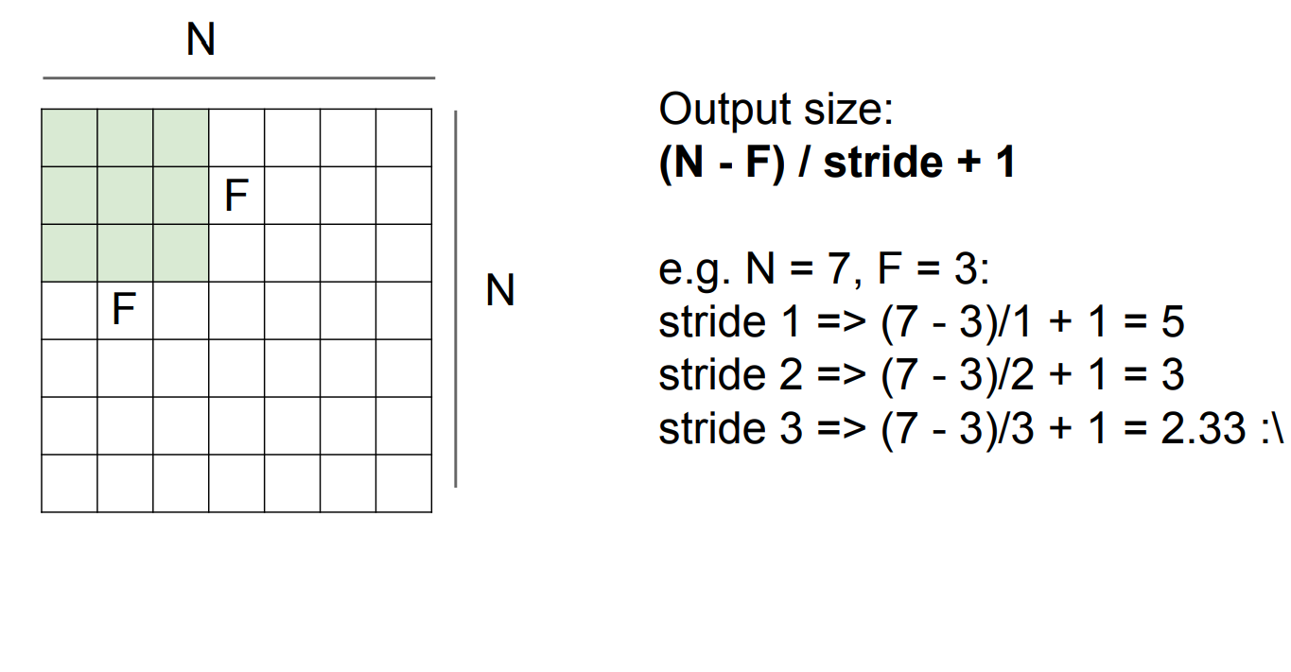

Slide 27
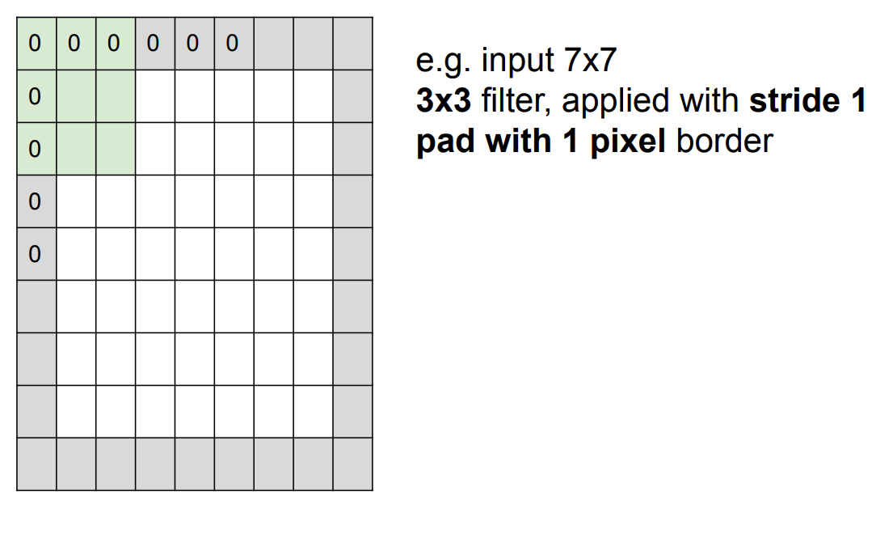
We can adjust our input to be compatible with given stride

Slide 28
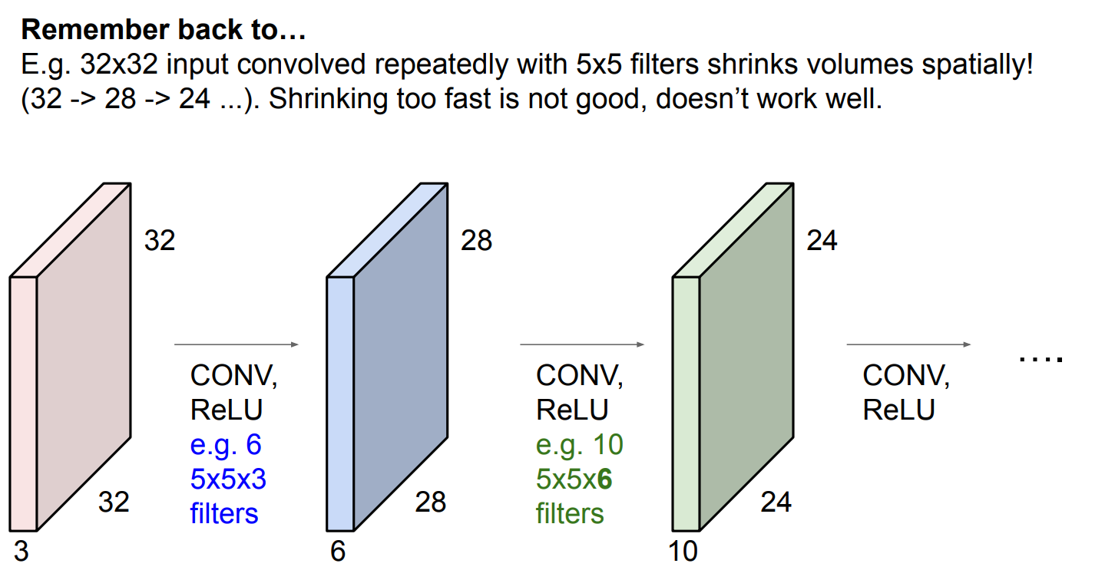
Shrinking the dimensions too fast is not desirable

Slide 29
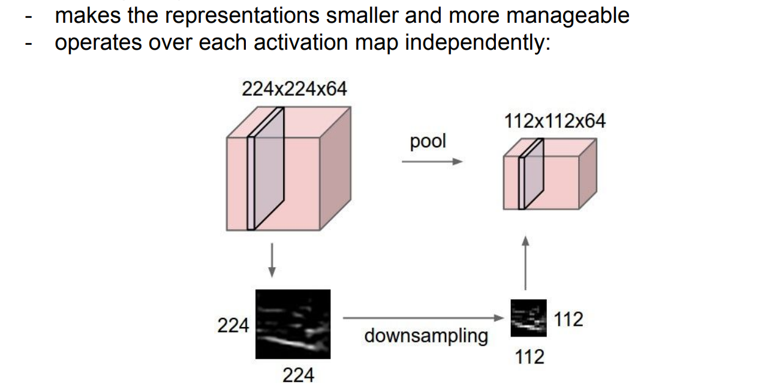
Max Pooling

Slide 30
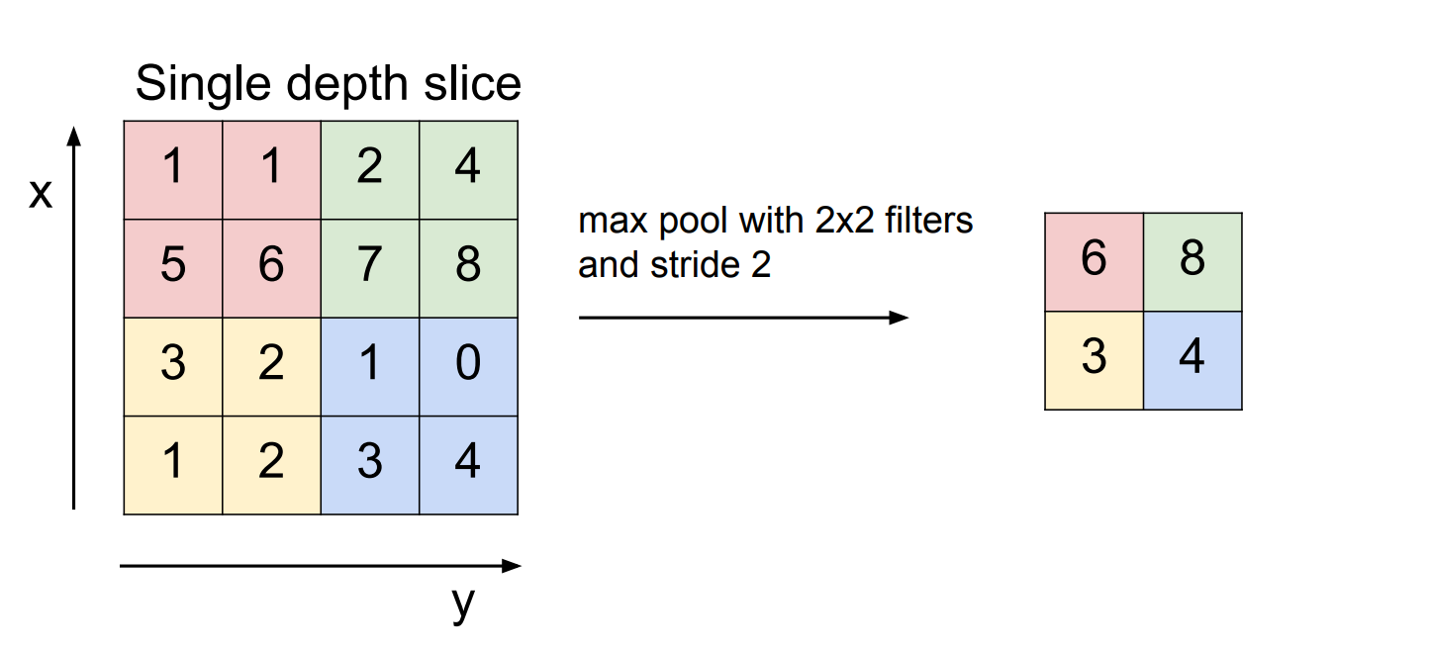
Max Pooling

Slide 31
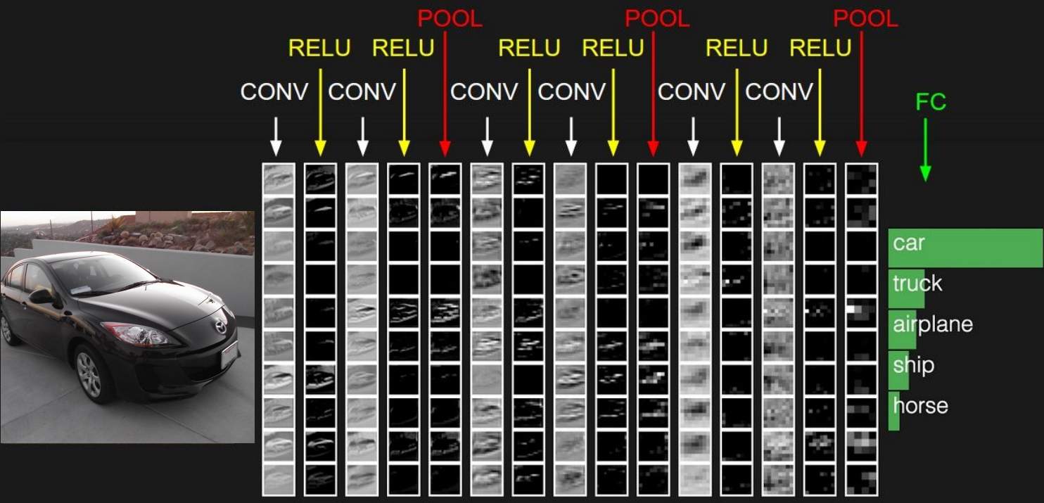
Final architecture

Slide 32
Thank you for attention!

